Slide 1
Levels of formality
Language functions
  Examples of functions: agreeing, apologizing, making a request, complaining, etc.
  Different expressions for each function
How do we choose a suitable expression?
  Formal situation FORMAL LANGUAGE
  Informal situation INFORMAL LANGUAGE
  Neither formal nor informal NEUTRAL LANG.
Great!
I’m delighted to hear that

Slide 2
Formal vs. informal situations
How do we decide how formal or informal a situation is?
  Where you are and when (i.e. the place or the occasion)
    THE SETTING
  What you are talking about
    THE TOPIC
  Who you are talking to (e.g. a friend, your employer)
    YOUR SOCIAL RELATIONSHIP
  What you feel about the topic or the other person
    YOUR PSYCHOLOGICAL ATTITUDE
For example:
CONFERENCE + IMPORTANT PROJECT + SENIOR COLLEAGUE + VERY SERIOUS = FORMAL LANGUAGE

Slide 3
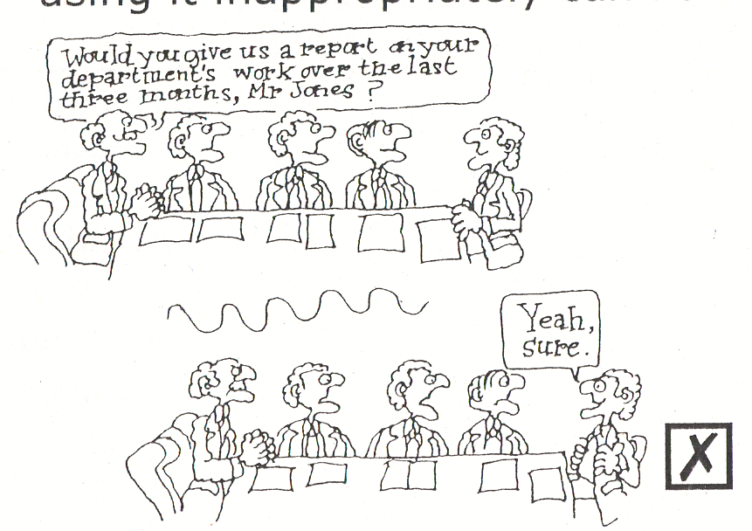
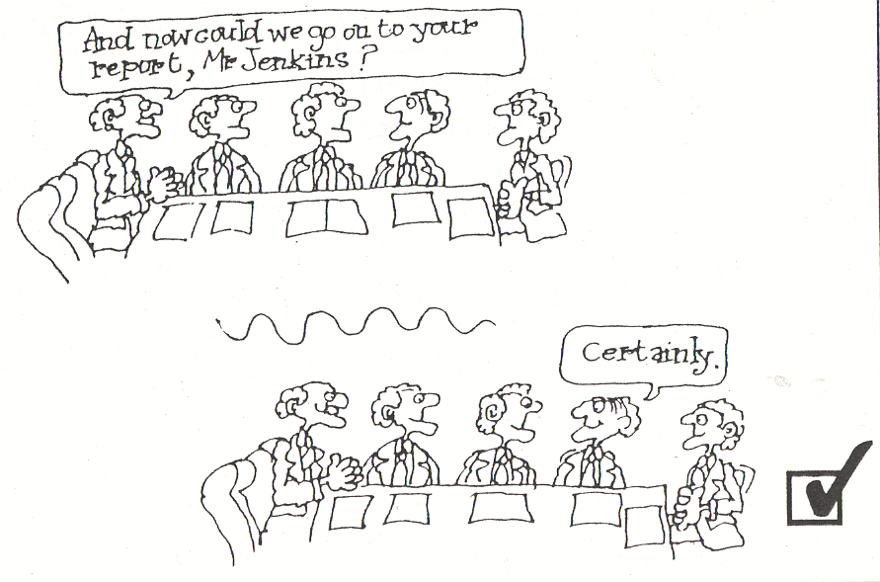
Using appropriate expressions
All four factors influence the way we speak
    INFORMAL SETTING ≠ INFORMAL LANGUAGE
For example:
hotel bar + business deal + director of overseas company+ very serious = FORMAL LANGUAGE
Saying the right thing at the right time
Using language appropriately helps to improve communication, but using it inappropriately can have the opposite effect:

Slide 4
Functions at different levels of formality
 | Informal | Neutral | Formal
Saying you’re wrong | My mistake. Sorry, I got it all wrong. Yes, silly of me. | Yes, of course. Yes, perhaps I’m wrong there. | Yes, I must admit you’re right Yes, I’m afraid I didn’t take X into account.
Asking for permission
Requesting
Complaining
Introducing someone
Giving reasons
Asking for opinions
Saying you’re not sure

Slide 5
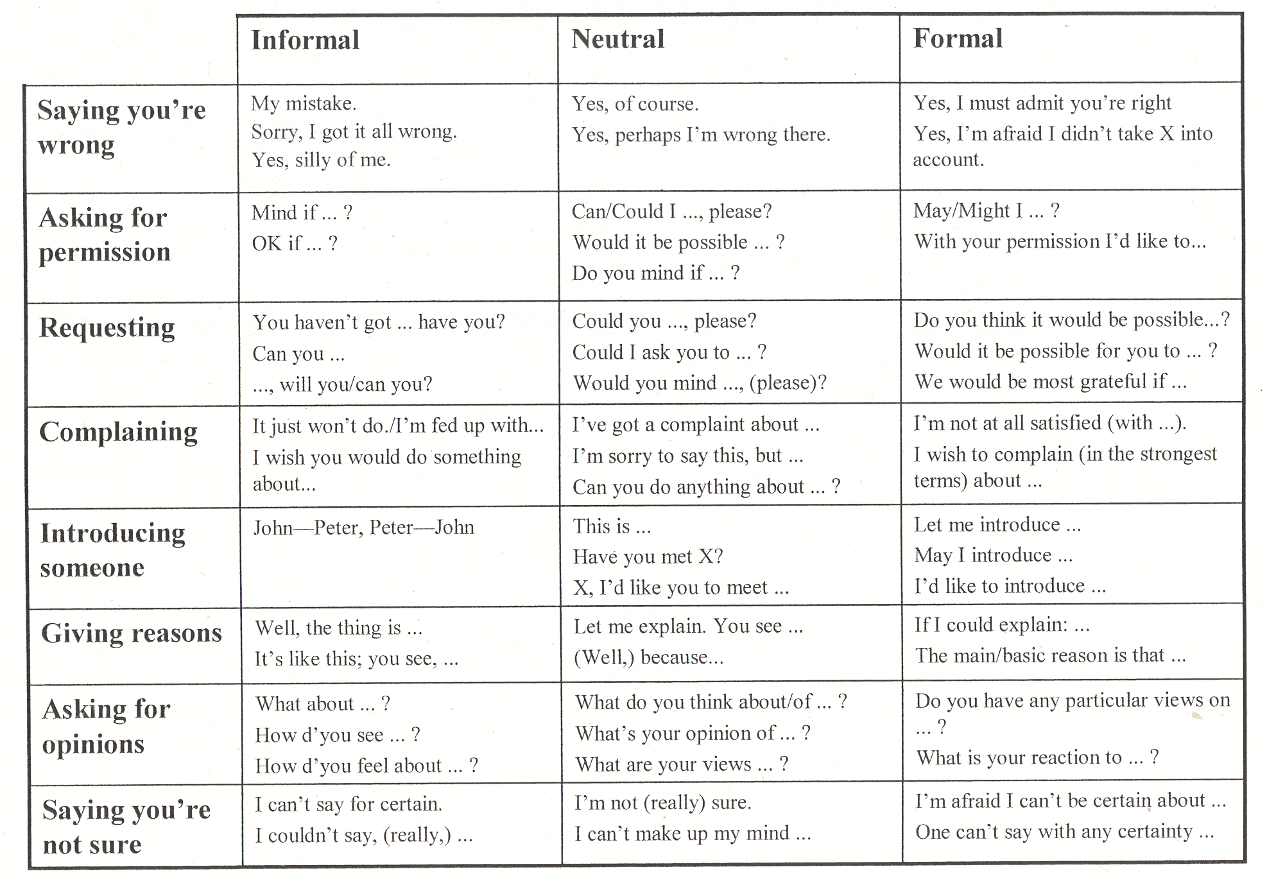
Functions at different levels of formality

